Slide 1


Slide 2
Hi. I’m Gladys Barsotti. What’s your name?
My name is ________________________
Nice to meet you!
___________________________________

Slide 3
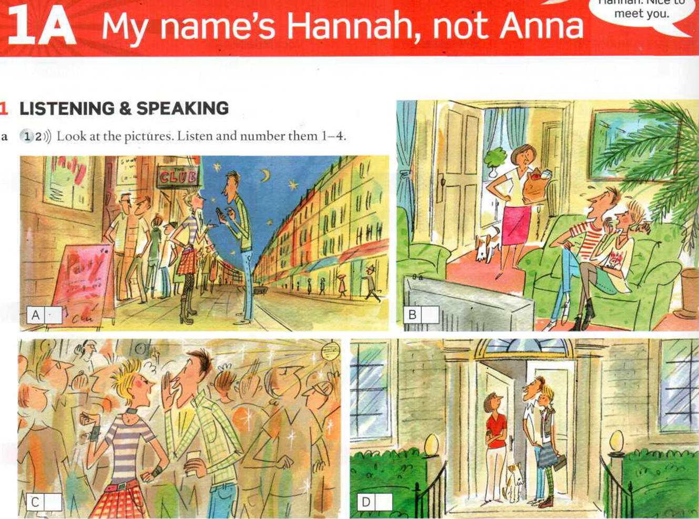


Slide 4
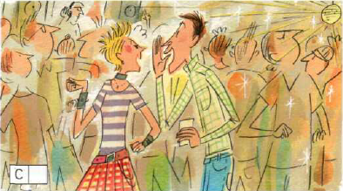
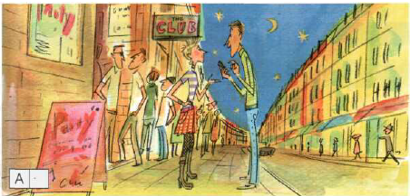
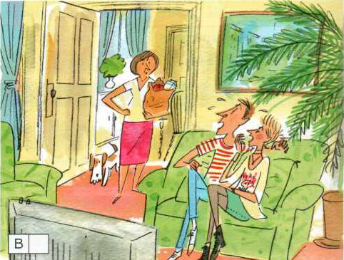
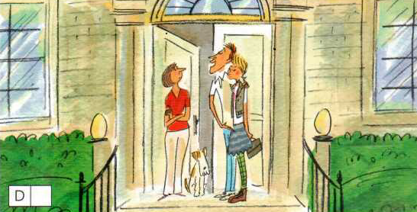
1
2
3
4

Slide 5
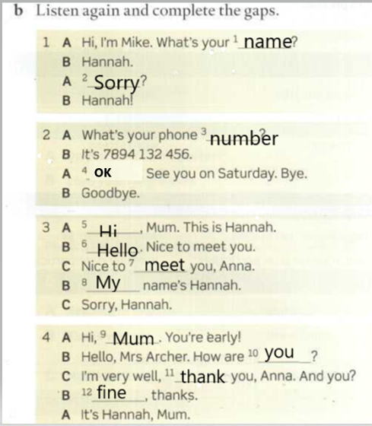
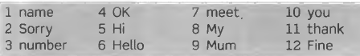
Page 4.
Listen, complete, practice and MEMORIZE the dialogues.

Slide 6
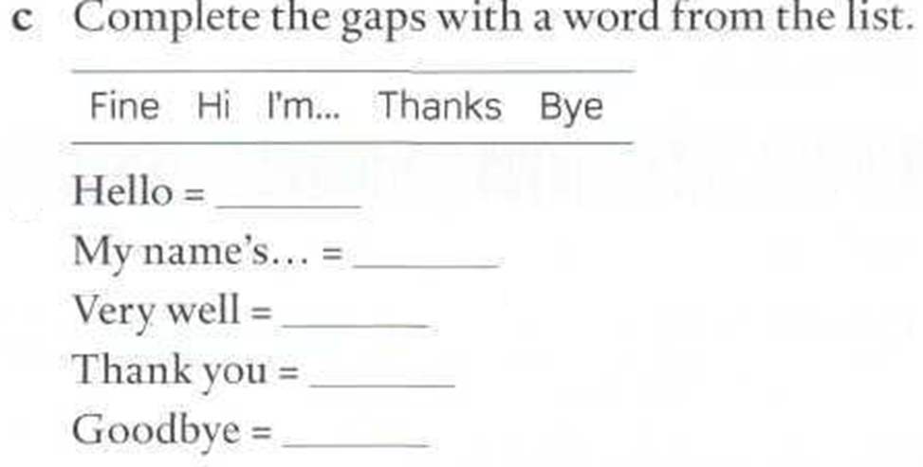
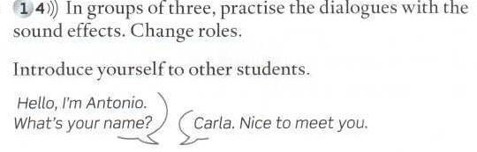
Hi
I’m…
Fine
Thanks
Bye

Slide 7
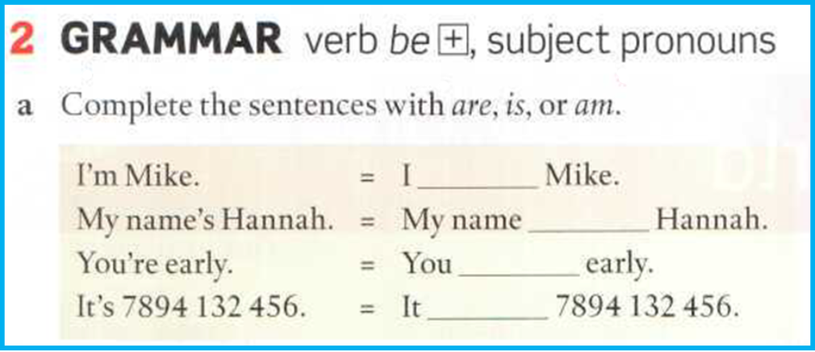
Page 5
am
is
are
is

Slide 8

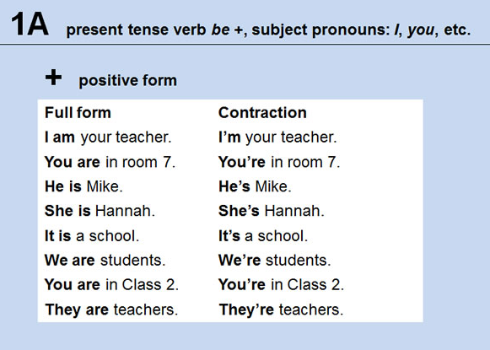
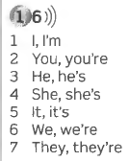
Go to page 124 Grammar Bank. Listen, repeat and practice reading the sentences.

Slide 9
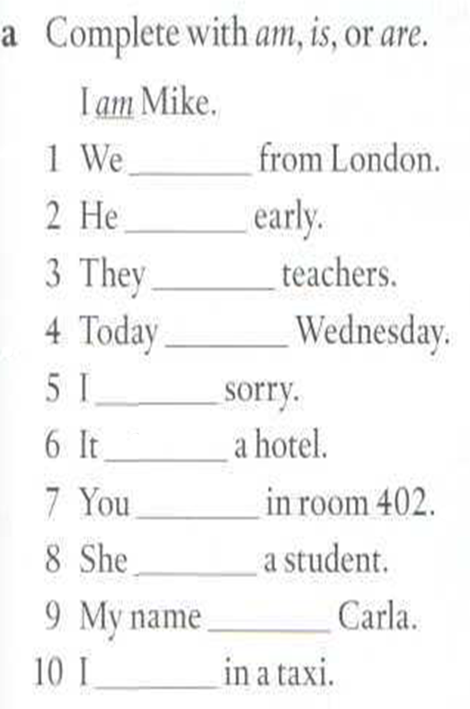
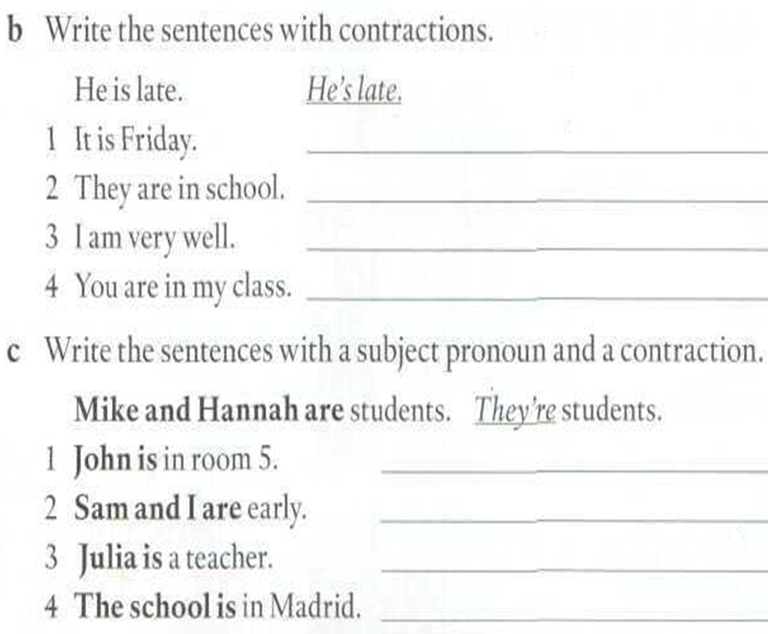
are
It’s Friday.
is
They’re in school
are
I’m very well.
is
You’re in my class.
am
is
are
He’s in room 5.
is
We’re early
is
She’s a teacher
am
It’s in Madrid

Slide 10

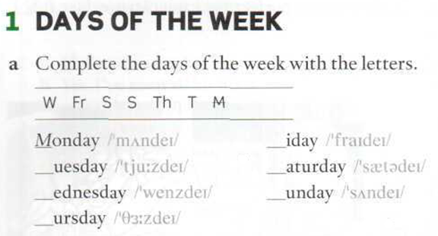
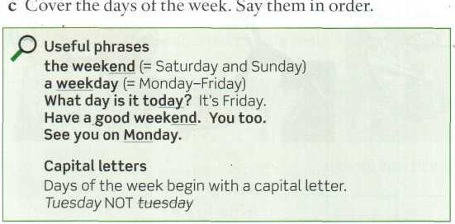
Page 148

Slide 11
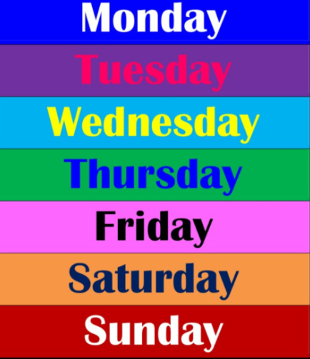


Slide 12
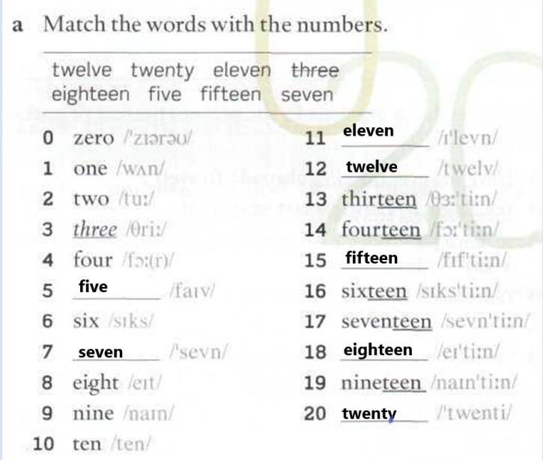
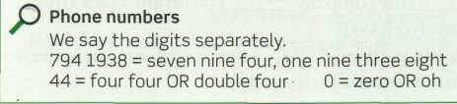
WHAT’S YOUR PHONE NUMBER?

Slide 13
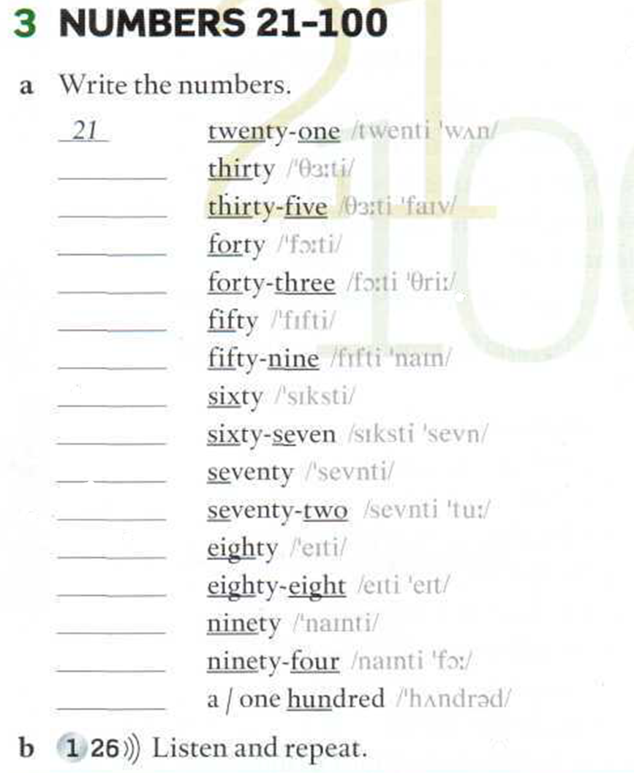
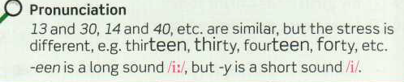
30
35
40
43
50
59
60
67
70
72
80
88
90
94
100

Slide 14
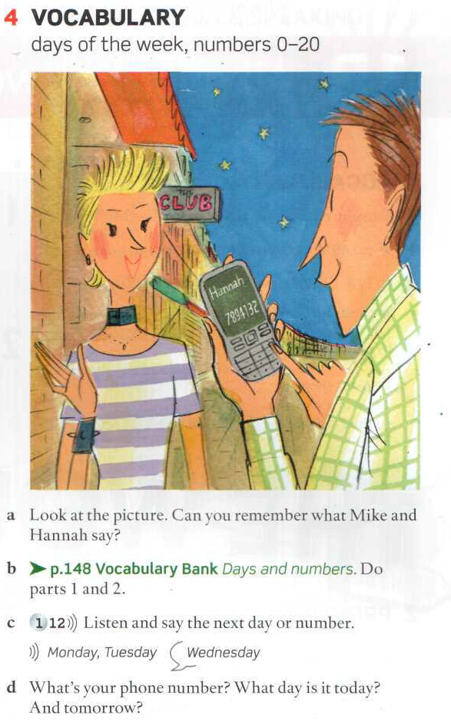
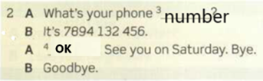
Listen and say the next day or number.
Listen and respond appropriately.
Listen and write the numbers you hear

